Slide 1


Microsoft Office 365 Arizona Western College
Marybel Garcia
Robert Schroeder

Slide 2
What is Office 365?
Latest versions of Microsoft Office applications, like Word, Excel, PowerPoint, and Outlook
5 TB of OneDrive cloud storage
Microsoft Office mobile apps to use across devices (PCs, Macs, tablets, and phones)

Slide 3

What is Office 365?
Because O365 works with all your devices, you can start creating on your PC or Mac, continue editing on your tablet, and then finish up on your phone.
This is possible because you can save your files to the cloud on OneDrive and get to them from anywhere.

Slide 4
What is Office 365?
O365 comes with mobile versions of Office for all your devices. These mobile apps come with premium features not available with other solutions.
O365 is built for the modern world so you can use it anywhere.

Slide 5
What is Office 365?
Desktop Apps
Word, Excel, PowerPoint, and more
Online Services
Outlook, OneDrive, Microsoft Teams
Business Apps
Microsoft Bookings, Sway, Planner

Slide 6
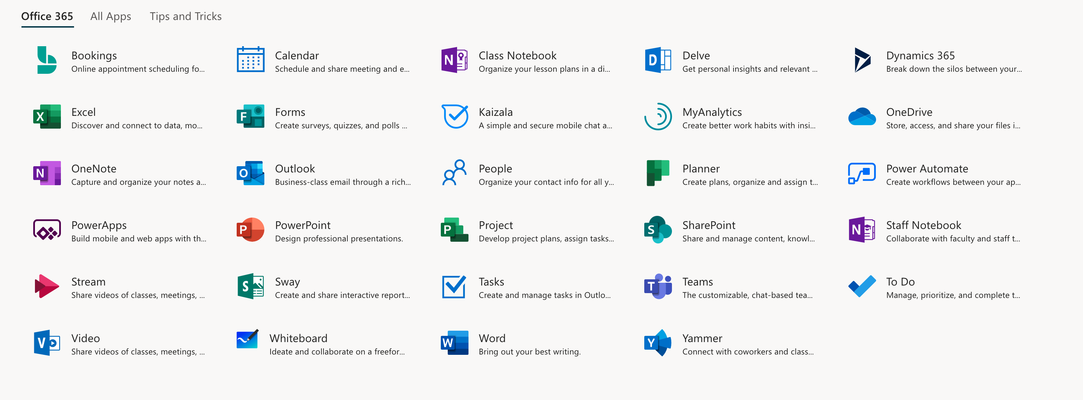
What is Office 365?

Slide 7
Office 365 Apps
Word: This app sets the standard for word processors and is available with Office 365 for both Business and Premium. If users in your enterprise need to create documents, this is the tool they will use.
Excel: The spreadsheet has been the workhorse for basic data analysis since its invention back in the previous century. Excel is the current standard-bearer and comes with Office 365 for Business and Premium.

Slide 8

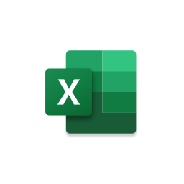
Office 365 Apps
Word: This app sets the standard for word processors and is available with Office 365 for both Business and Premium. If users in your enterprise need to create documents, this is the tool they will use.
Excel: The spreadsheet has been the workhorse for basic data analysis since its invention back in the previous century. Excel is the current standard-bearer and comes with Office 365 for Business and Premium.

Slide 9
Office 365 Apps
Outlook: Office 365's solution for managing email and an appointment calendar is called Outlook. The app has been around for many years and its busy interface tends to be either loved or hated by users. It's available with both the Business and Premium subscriptions.
PowerPoint: Communicating information to a group of individuals at a meeting often involves a presentation. Office 365's PowerPoint allows users to create, display, and disseminate information in formats ranging from the basic slide to animation to video.
OneNote: As the workforce has become more mobile, the need to capture information on the go has become increasingly important. Applications like OneNote allow users to take notes on any device and then retrieve those notes from any other device. It's your basic productivity cloud app.

Slide 10
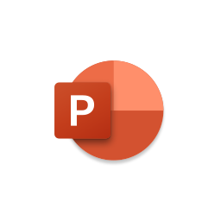
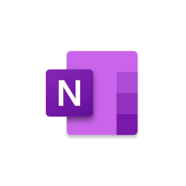

Office 365 Apps
OneNote: As the workforce has become more mobile, the need to capture information on the go has become increasingly important. Applications like OneNote allow users to take notes on any device and then retrieve those notes from any other device. It's your basic productivity cloud app.
Outlook: Office 365's solution for managing email and an appointment calendar is called Outlook. The app has been around for many years and its busy interface tends to be either loved or hated by users. It's available with both the Business and Premium subscriptions.
PowerPoint: Communicating information to a group of individuals at a meeting often involves a presentation. Office 365's PowerPoint allows users to create, display, and disseminate information in formats ranging from the basic slide to animation to video.

Slide 11
Office 365 Apps
Collaboration tools: Along with the typical productivity applications, Office 365 includes many collaboration tools--like Delve, Yammer, and Sway. These tools allow users to communicate, brainstorm ideas, share documents, and have video meetings while on the go.

Slide 12
Office 365 Apps
Collaboration tools: Along with the typical productivity applications, Office 365 includes many collaboration tools--like Delve, Yammer, and Sway. These tools allow users to communicate, brainstorm ideas, share documents, and have video meetings while on the go.

Slide 13
Office 365 Apps
Microsoft Teams: Members of the modern enterprise workforce are very familiar and comfortable with chat applications. To satisfy the needs of those employees, Office 365 now includes Microsoft Teams, a chat-based workspace that integrates people, content, and tools into a single platform.

Slide 14

Office 365 Apps
Microsoft Teams: Members of the modern enterprise workforce are very familiar and comfortable with chat applications. To satisfy the needs of those employees, Office 365 now includes Microsoft Teams, a chat-based workspace that integrates people, content, and tools into a single platform.

Slide 15
Office 365 Apps
To-Do: An update to Microsoft Office 365 has added the To-Do app to the productivity suite. No longer an afterthought piggybacking on the Calendar app, To-Do is now a feature-rich standalone application that integrates with the rest of Office 365.
Publisher: Sometimes communicating information to a broader audience requires something more permanent and more formal than a presentation at a meeting. The Publisher app in Office 365 provides users with the tools they need to publish professional-looking newsletters, brochures, and booklets.

Slide 16


Office 365 Apps
To-Do: An update to Microsoft Office 365 has added the To-Do app to the productivity suite. No longer an afterthought piggybacking on the Calendar app, To-Do is now a feature-rich standalone application that integrates with the rest of Office 365.
Publisher: Sometimes communicating information to a broader audience requires something more permanent and more formal than a presentation at a meeting. The Publisher app in Office 365 provides users with the tools they need to publish professional-looking newsletters, brochures, and booklets.

Slide 17
Office 365 - OneDrive
5TB of personal cloud storage
How much is 5TB?
85,000 hours of music
5,000 hours (208 days) of video
1,550,000 photos
2,500 hours of movies

Slide 18
Office 365 - OneDrive
Store any type of file including images, spreadsheets, presentations, and more.
Supports over 300 different file types.
Easily share files within OneDrive, allow editing of the file, even deny download of the file, if desired.
Turn off file sharing anytime you want.
Keep OneDrive organized with folders and find individual files with the 'Search Everything' option.

Slide 19
Office 365 - Arizona Western College
As an employee of Arizona Western College you get access to the online version of Office 365 anywhere that you are connected to the Internet.
As an employee of Arizona Western College you also get access to install a copy of the Microsoft Office suite on up to 5 of your personal computers.

Slide 20
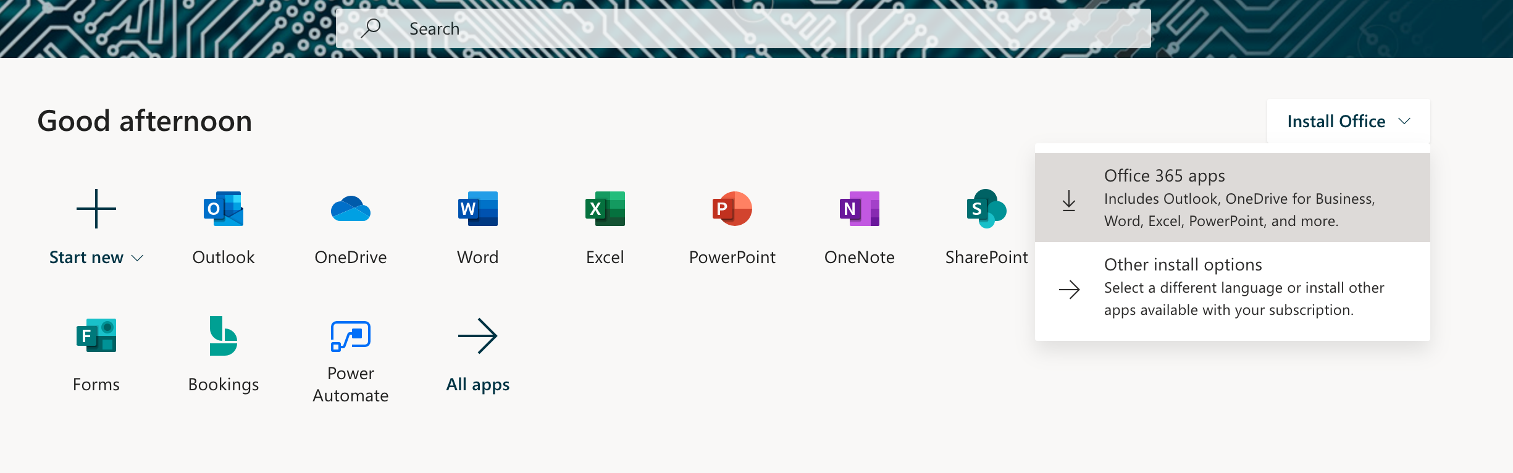
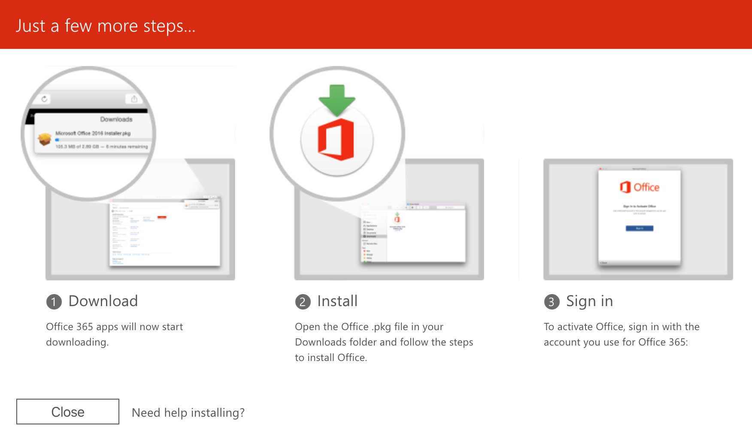
Office 365 - Arizona Western College
To install Microsoft Office at home:
Navigate to https://www.office.com/
Sign in with your AWC email address and password
Click "Install Office" in the top right of your web browser and select "Office 365 apps"
Follow the instructions on the next pop-up window to finish installing the software.

Slide 21
Office 365 - Additional Resources
Microsoft Office Cheat Sheets
Microsoft Office Cheat Sheets
Office 365 Training Center
Office 365 Training Center
Office 365 Quick Starts
Office Quick Starts
Switching to Office 365 (From G Suite)
Switch to Office 365
The AWC Service Desk

Slide 22

Office 365 – Questions?
Please leave your email address or contact information with us if you would like a copy of this presentation.

